Slide 1

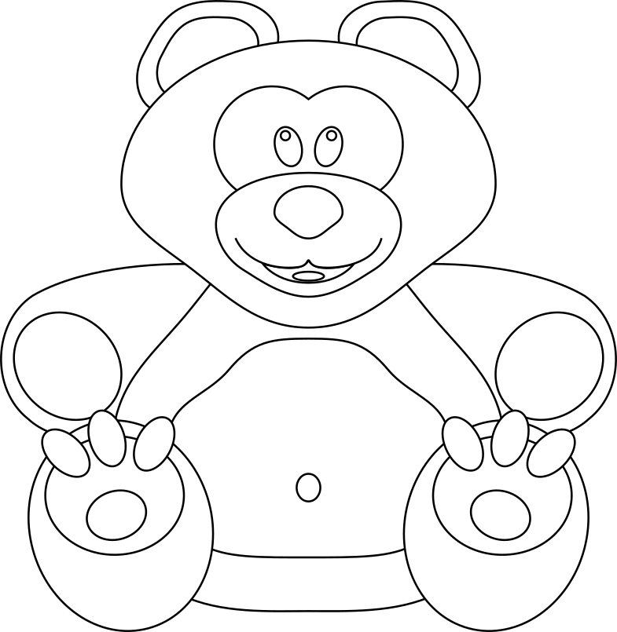

Year 5 – Systems and searching Lesson 1 – Systems | Learner activity sheet
Digital Ted
Inputs
Outputs
Processes
Resources are updated regularly — the latest version is available at: ncce.io/tcc.
This resource is licensed under the Open Government Licence, version 3. For more information on this licence, see ncce.io/ogl.
Notes:
Last updated: 31-01-22
Image source: https://pixabay.com/vectors/teddy-bear-bear-knuffig-cuddly-447415/

